Slide 1

SUSTAINA-TROPOLIS
Towards Sustainable Environment
Created By :
Siddhartha Singh
Arpit Agrawal

Slide 2
Social Cause
Our game is centered creating awareness about sustainable development, required for cities in this day and age. To do this, we focus on water and energy infrastructure. Since, both may be facing problems in the future.
A lot of our water management infrastructure like dam is aging and requires replacement in the near future. Our power infrastructure must switch to more renewable sources like solar, wind and hydro-electric power plants. Hence, these have prominence in our game.

Slide 3
Target Audience
Our game can be enjoyed by any age-group. Though we are primarily targeting school going children whose awareness in these matters will decide the state of our future.

Slide 4
Game Design
This is a turn Based Game, where each turn represents a season. Our aim is to maximise the population of the cities at the end of 5-years time. To increase the population of the city, the player must create housing and ensure sufficient supply of water and power. The player is also informed about various upcoming events like heavy rain prediction, droughts, etc. , which helps to predicts fluctuations in water’s/power’s supply/demand.
We also wanted to emphasize the importance of maintaining the infrastructure on which cities run. Hence, we added the feature of infrastructure degrading with time which player would have to repair.

Slide 5
Programming Languages and Libraries
We used python programming language to make development easier, since we wanted to add multiple types of projects which had various ways of affecting each other and our graphics were not too heavy to render, so the speed of python was not a concern.
Since, our game idea required a significant amount of UI and since the user would continuously see this UI, it’s appearance was also important, Hence, we used the pygame_gui library for this purpose.We also had to create many custom components to fit the look for our game and for providing features like moving progress bar not present in the pygame_gui library.
We also used the default json module in python to parse the json files we used
in our game.

Slide 6
Rendering and Graphics
Since, our game requires mainly placing different objects, technically a 2-D game would suffice. But, to have a better and more elegant look we decided to use an isometric art-style. This allowed us to achieve a 3-D like look.
We wrote all the code for managing the rendering in isometric-style and for selecting and adding objects.
We also added a simple animation for windmills using a list of images to simulate windmill’s movement.

Slide 7
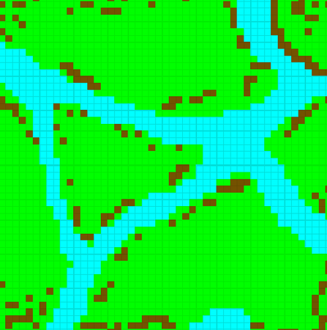
Easy Modification
It is important to balance the relation between different components in game like this, like how much water a city can consume or how much water can a water tank store. We may also want to add other features like a sewage treatment plant.
To make this easier we have used JSON files to abstract out different parameters like cost, maintenance rate, Img paths, etc. from the main python code, so that balancing the game by changing these parameters is much easier.
We also made a basic map editor where by editing an image, we could change the corresponding map in the game.

Slide 8
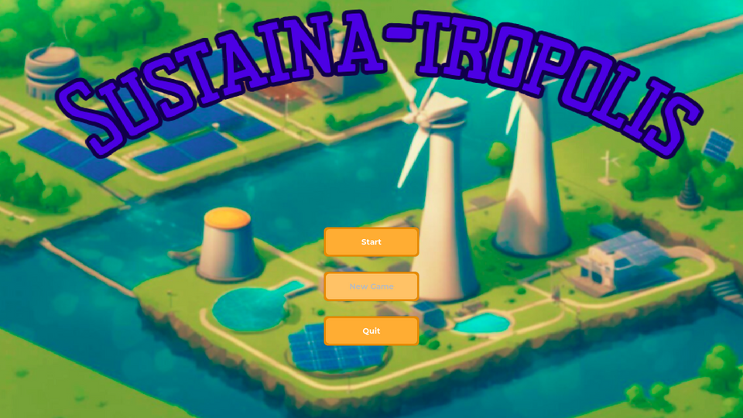
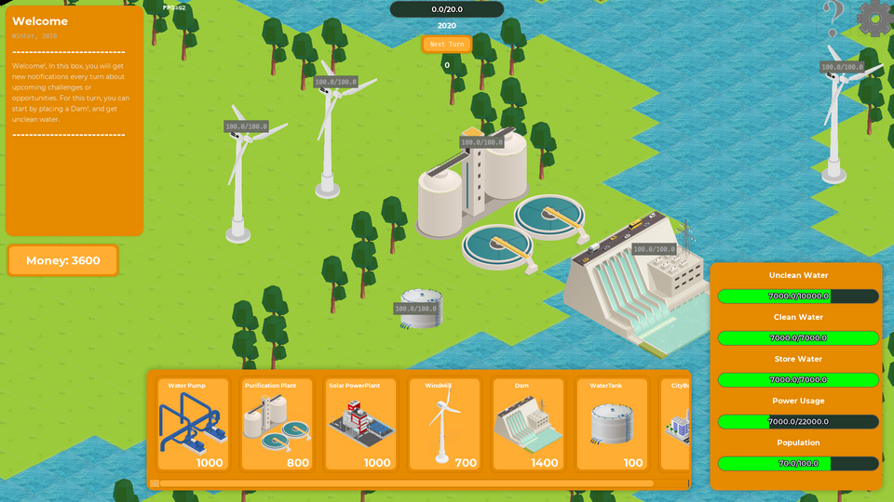
Implementation Highlights
Start Page
Game Map

Slide 9
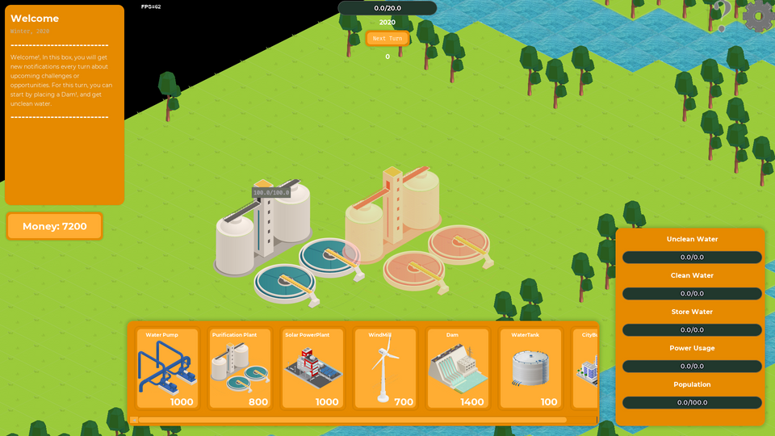
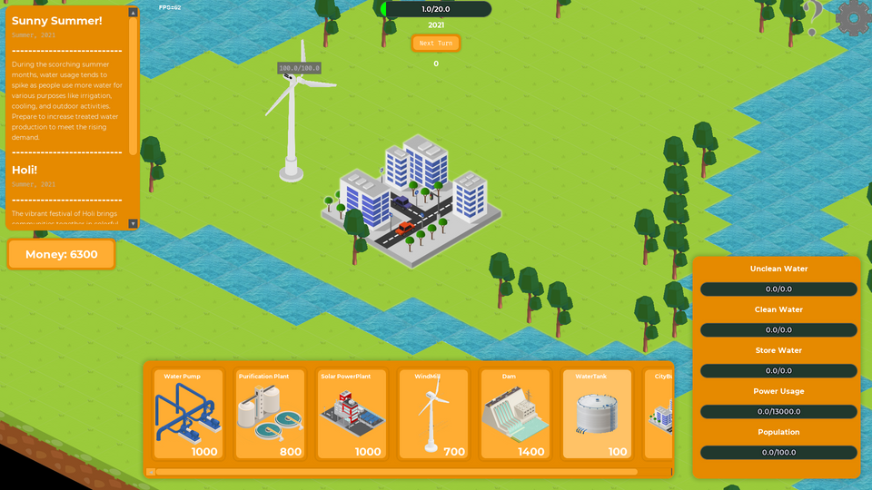
Implementation Highlights
Project Placement
Game UI

Slide 10
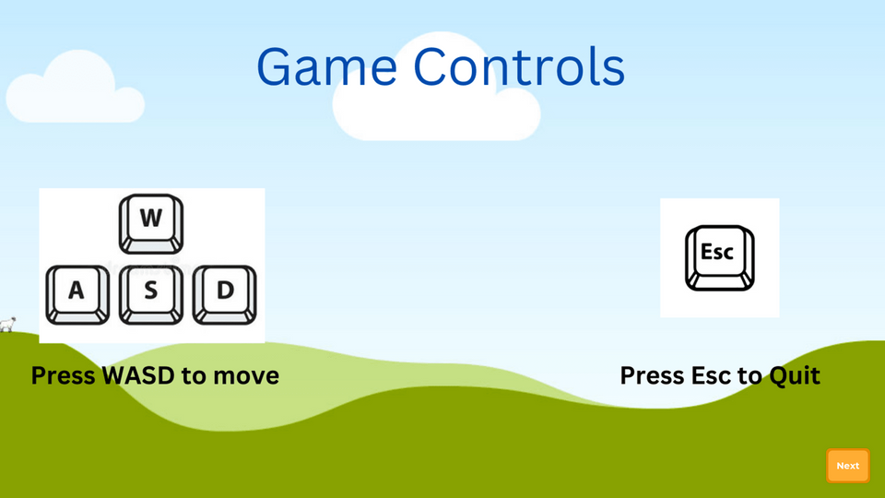
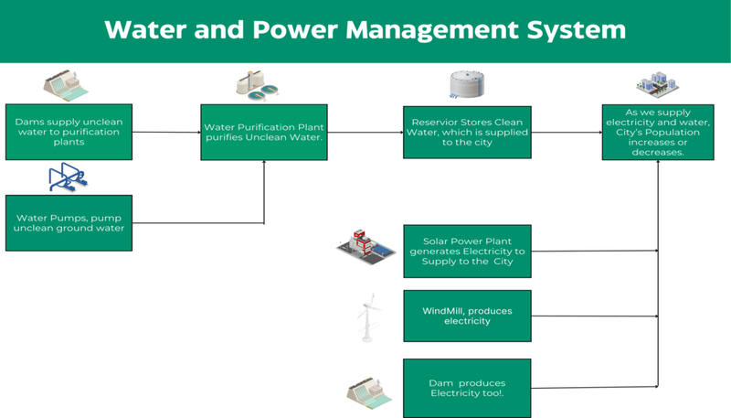
Implementation Highlights
Game Controls
Infrastructure Explain

Slide 11
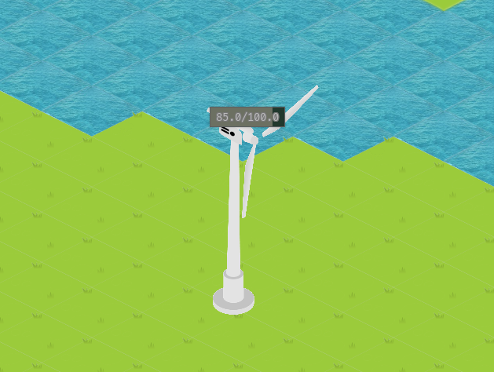
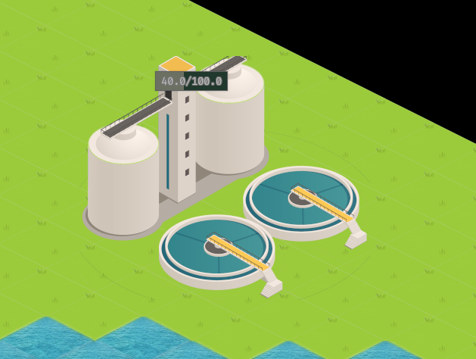
Implementation Highlights
WindMill Animation
Maintenance Bar

Slide 12
Metrics For Evaluation
1) We have abstracted out the parameters (Cost, Map Design, etc) to make modifications easier.
2) Our game provides simple user-friendly UI and explanations for new players.
3) Usage of isometric-art style for more 3D like look.
4) Including all features like a explanations of game-mechanics and an intro-story which both integrate well with our cause of Sustainable Development.
5) We have added game saving functionality using which you can continue from the same season, you previously stopped.

Slide 13
Further Improvements
1) In India, many cities do not use sewage treatment plants to their full extent. Partially because of the infrastructure doesn’t exist yet and because people do not like the idea of drinking purified sewage. Adding this to our game could introduce the idea to many people
2) We could have added a high-score mechanism to make the game more competitive and engaging for the players.
3) To improve our graphics, we could have added animations to river water, dam, etc.

